Slide 1
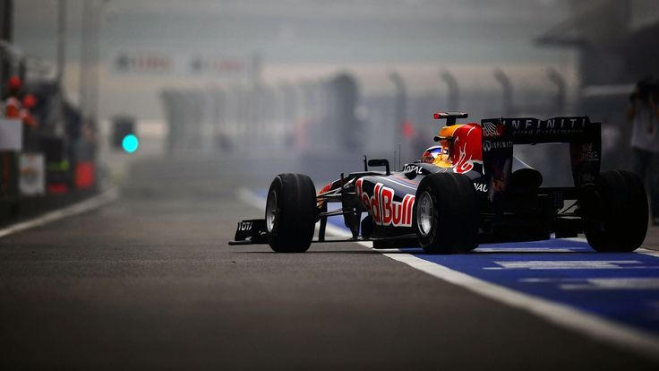
FORMULA-1 ANALYTICS

Slide 2

Meet our Team
Keshav Ram M
Khushi Mishra
Lakshmi Praba S
Lakshya R
Manjunath P

Slide 3

Content
Objective
Tech Stack
Workflow Diagram
Source Data and Model
Medallion Architecture
Orchestration
Dashboard
Challenges
Future Scope
Agenda
Presentation and Walkthrough – 30 min
QnA Session – 15 min

Slide 4
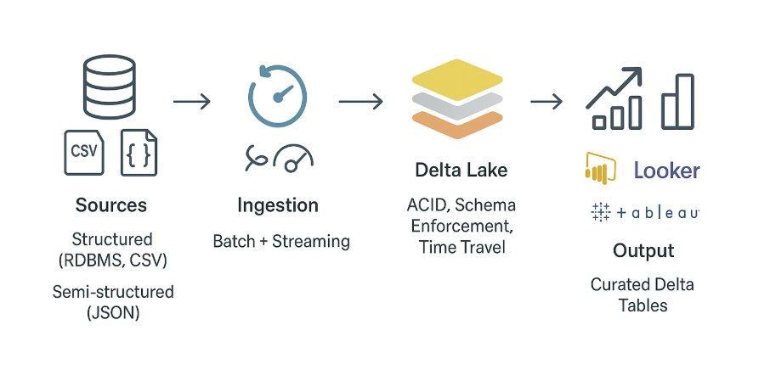
OBJECTIVE
To design and implement a Medallion Architecture (Bronze, Silver, Gold layers) for Formula 1 datasets using PySpark and Delta Lake.
To ensure data ingestion, cleaning, transformation, and enrichment through workflow pipelines.
To deliver a robust data architecture that supports reporting, dashboards, and advanced analytics.

Slide 5
Tech Stack
Cloud Storage:
Azure Data Lake Gen2
Compute Resources:
Interactive Cluster (DBX for dev)
Job cluster (for production)
RBAC & Security:
IAM Roles/Policies
Ingestion Tools:
Auto Loader
DataFrame Reader API
Languages & Querying:
PySpark, SQL, Python
Visualization / BI:
Power BI & Databricks Dashboard
Orchestration & Governance:
Databricks Jobs / Workflows
Unity Catalog

Slide 6
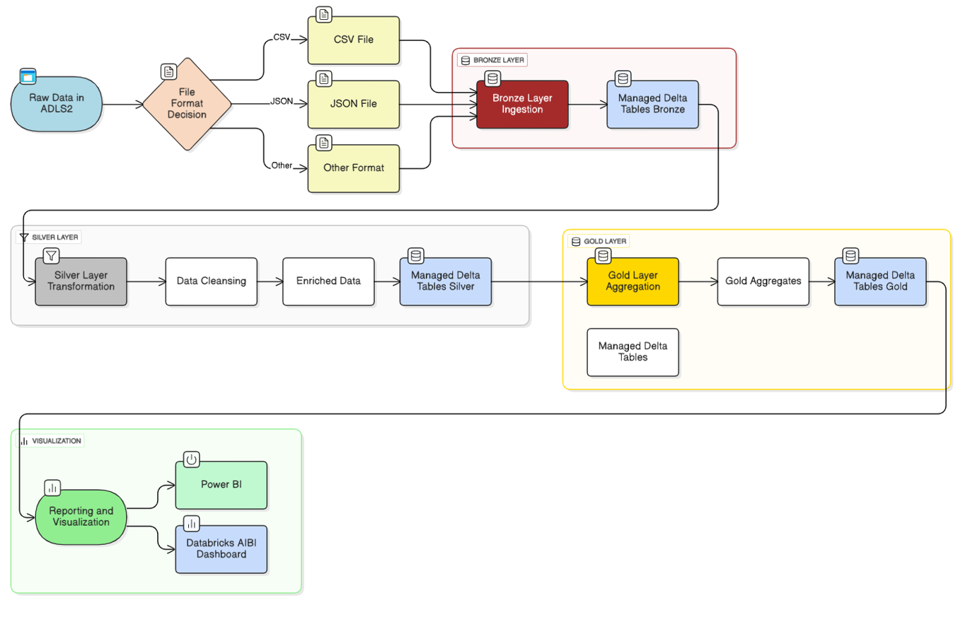
Workflow Diagram

Slide 7
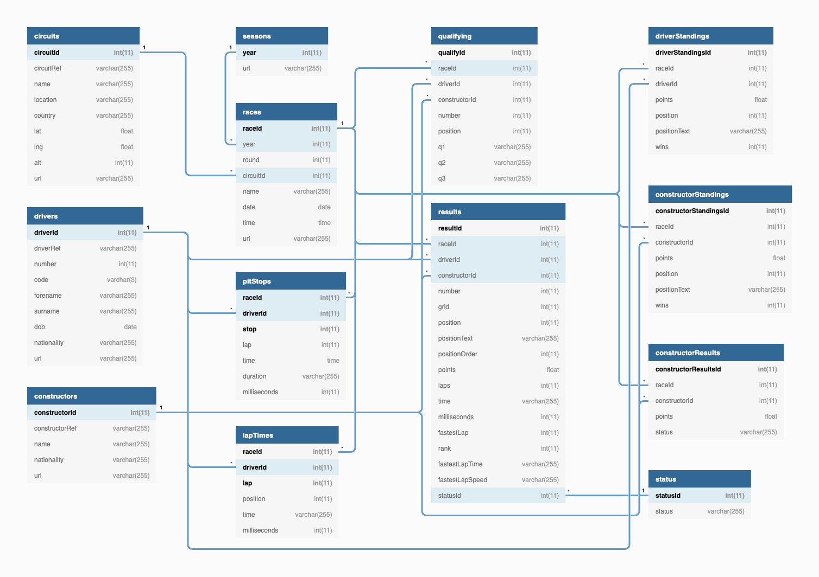
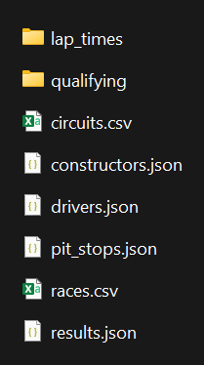
Source Data and Model

Slide 8
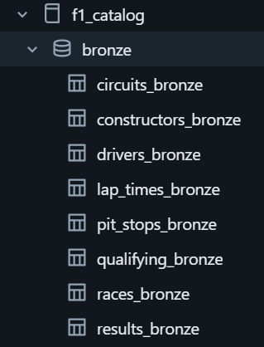
Bronze Layer
Batch Ingestion (Static Files)
Files: Circuits(CSV), Pit Stops(JSON multiline), Drivers(JSON), Constructors(JSON)
Read raw files from source path
Add metadata columns
Write to Delta Tables in bronze layer
Streaming Ingestion with Auto Loader
Files: Results(JSON), Races(CSV), Qualifying(JSON multiline), Lap Times(CSV)
Use cloudFiles (Auto Loader) for streaming ingestion
Define schemaLocation & checkpoint for incremental processing
Add metadata columns
Write to Delta Bronze Tables

Slide 9
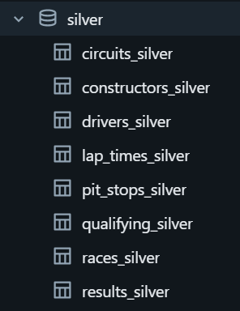
Silver Layer
Data is deduplicated to remove repeated records if exists
Null values handled - replacement, or removal
Schema inferred to ensure correct data types and structure
Columns renamed for consistency and readability
Provides clean, reliable data ready for downstream analytics and enrichment

Slide 10
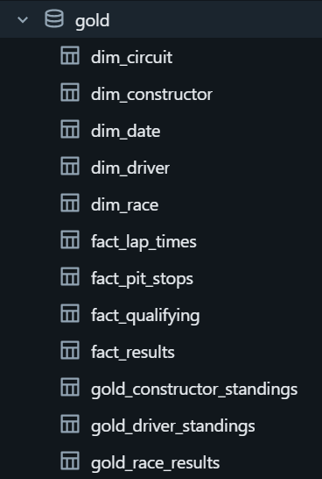
Gold Layer
Designed Dimensional Modeling (Constellation Schema) for analytics
Three aggregated tables created for reporting and dashboards
Optimized for fast queries and high performance for end-users
Provides a single version of truth for business metrics
Supports advanced analytics: trend analysis, KPI tracking, and forecasting

Slide 11
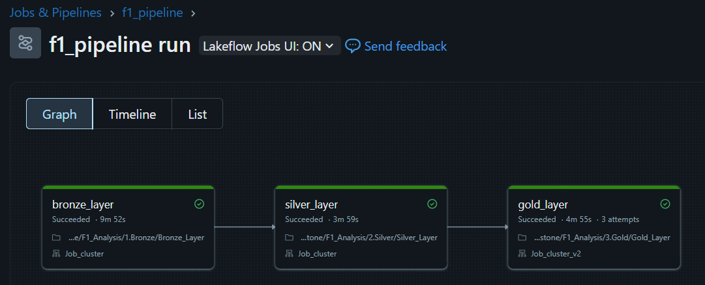
Orchestration
Orchestrated using Databricks Jobs with three tasks
Each task executes one notebook in sequence
Utilized a Job Cluster for execution:
Single-node cluster
16 GB RAM, 4 CPU cores
Ensures automated, scheduled, and reliable execution of the pipeline

Slide 12
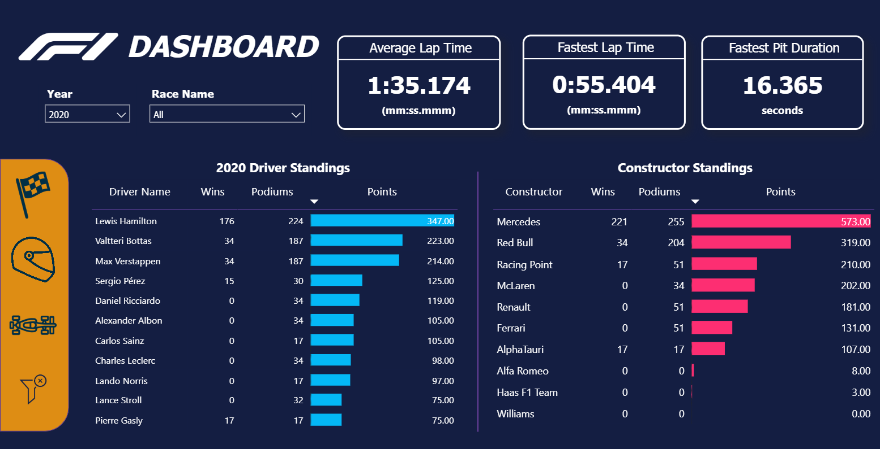
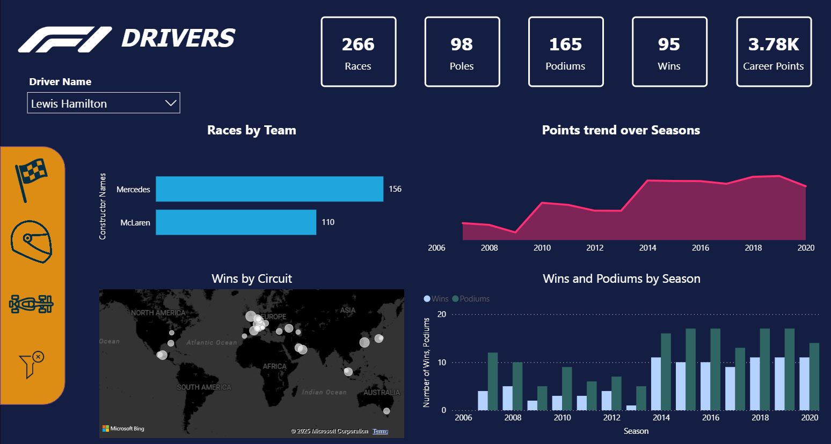
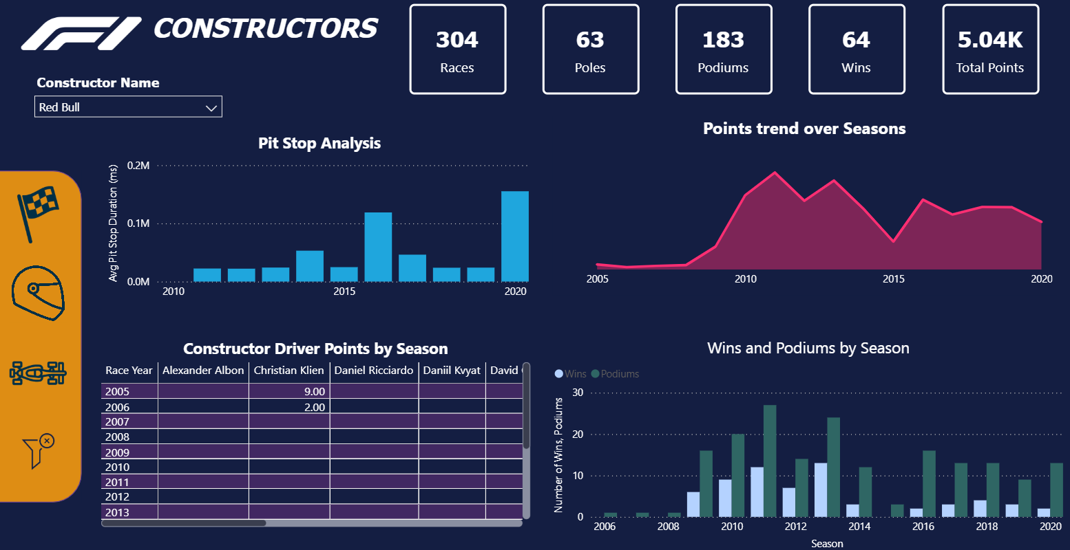
Power BI Dashboard

Slide 13
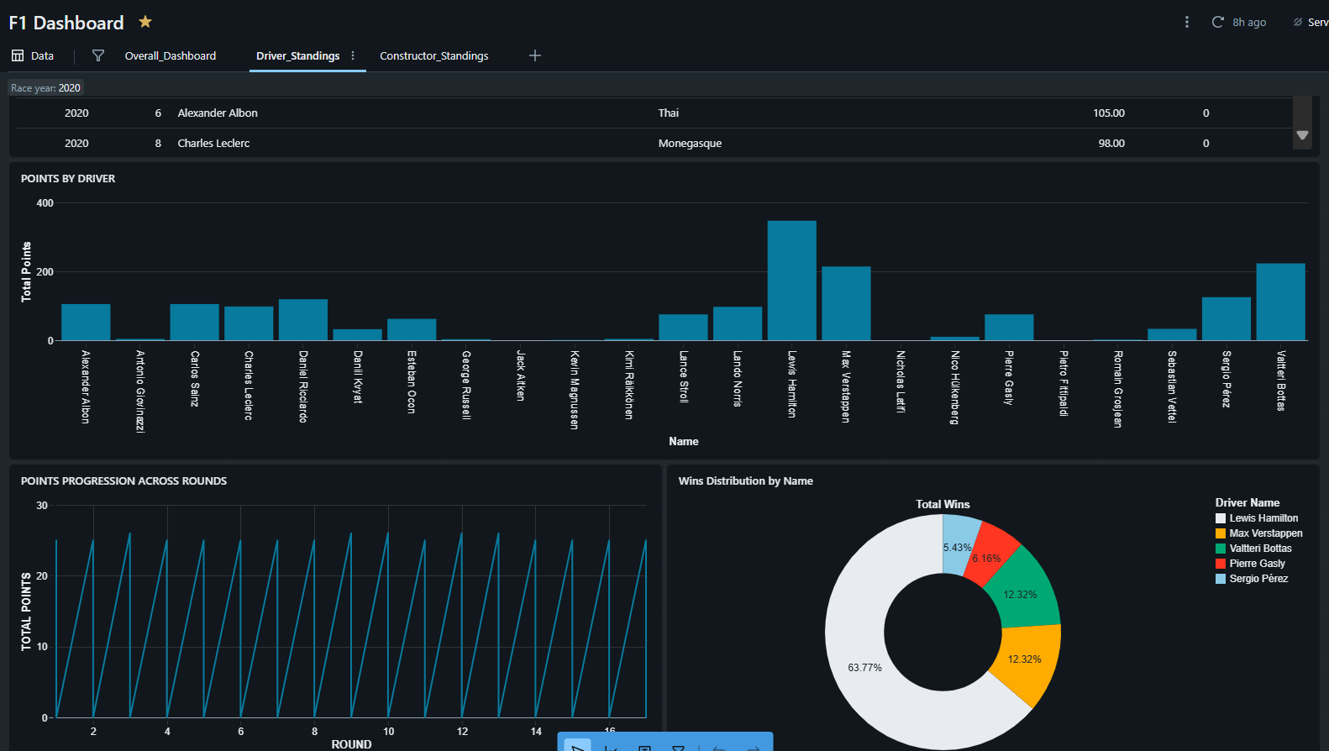
Databricks AI/BI Dashboard

Slide 14
Conclusion
Established Medallion Architecture (Bronze → Silver → Gold) using PySpark & Delta Lake.
Ensured scalable data ingestion, cleaning, and transformation workflows.
Enabled dashboards, KPIs, and advanced analytics for Formula 1 insights.
Built a robust, future-ready data foundation to support growth and innovation.

Slide 15
Challenges
Domain Knowledge Issues
Lack of exposure towards F1 dataset
Data Variety
Integrating multiple formats (CSV, JSON, Nested JSON formats).
Cloud resources and Cost optimization
Work with limited compute resources due to trial account
Collaboration and Role-Based Access Control
Ensuring proper access and working in tune

Slide 16
Future Scope
Performance Optimization
Use Delta Live Tables for robust production and monitoring
CI/CD for Data Pipelines
Automate deployments with Databricks Repos / GitHub Actions.
Advanced Analytics & ML
Build prediction and recommendation models using curated Delta tables.
Implement Streaming Data
Using Azure Event Hubs or Kafka.

